Slide 1


Corporate Presentation
2023

Slide 2
ABOUT US…
Sync NI is Northern Ireland’s #1 destination for tech-focused news, careers, and events with a captive audience of over 75k IT professionals, tech enthusiasts, and students each month
We provide a single platform for HR, PR, and Marketing departments to engage and interact with NI’s technology eco-system
Sync NI produces in-depth articles, features, and interviews, providing valuable insights and thought leadership across every area of technology

Slide 3
WHAT WE DO…
As NI’s largest tech community we work with corporate, public sector and academic bodies to successfully deliver key objectives for Marketing, PR, and HR departments across our digital, print and social channels
We invite key stakeholders to participate in networking events and roundtable sessions to shine a spotlight on all the crucial issues affecting NI’s tech sector
Sync NI offers a single destination for employer branding and attracting talent to Northern Ireland’s top technology companies

Slide 4
AREAS WE COVER…
Women in Tech
A.I.
Education & Careers in Tech
Start-Ups
Engineering
Cyber Security
Media & Entertainment
Professional Services
Fin Tech
Med Tech
Future Tech
Green Tech
Data
Global
Telecoms
See an area we’re missing?
Let us know!

Slide 5
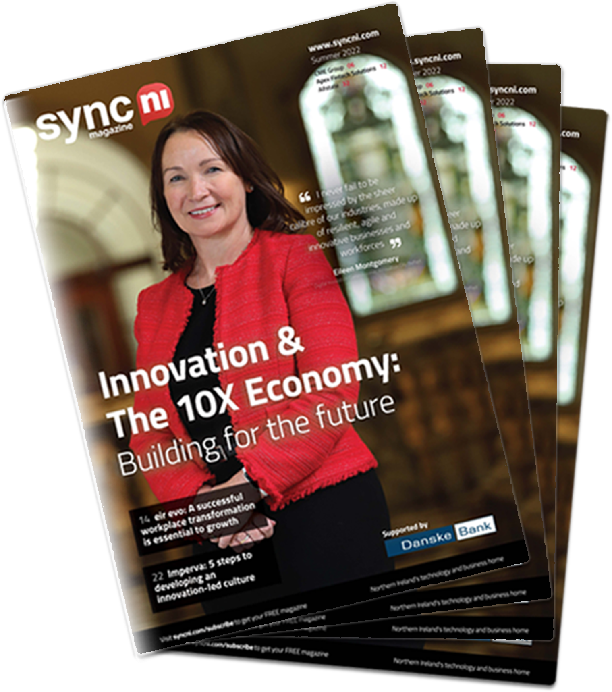
PRINT & DIGITAL MAGAZINE…
Sync NI produces quarterly magazines delivering in-depth features and analysis on important developments and issues within the technology sector and the wider economy
Content Distribution
Print edition
Distributed to Senior Management (including HR and Marketing Depts) in NI Corporate Tech, Education, and Multiple Public Sectors
Online/PDF Edition
Downloadable from our website and emailed directly to subscribers

Slide 6
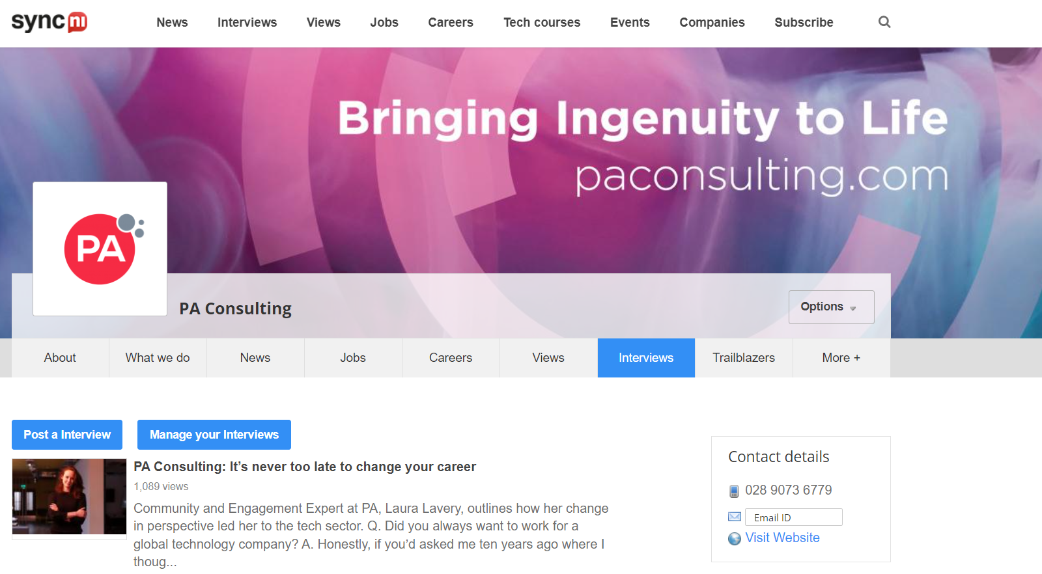
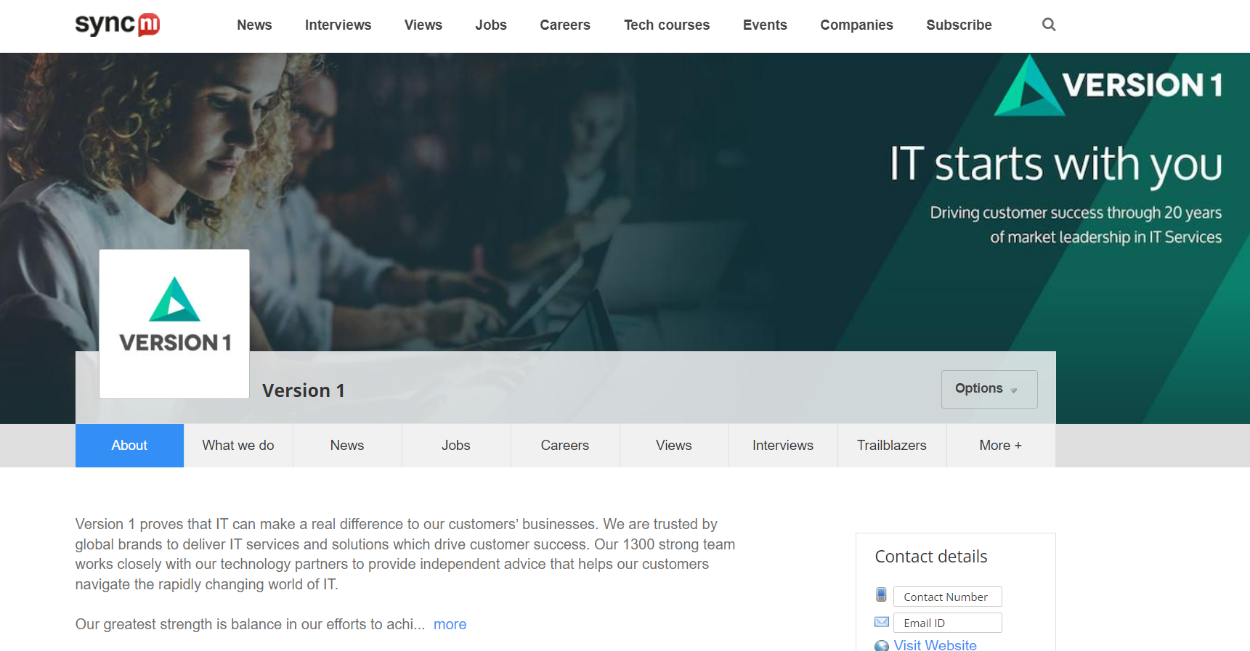
DEDICATED COMPANY HUBS…
Clients receive a Dedicated Company Hub within the Sync NI website to post news, jobs, events, archive content, and banner advertising across the site to maximise brand visibility
Editorial features and content are extensively promoted across all of Sync NI’s print, digital and social channels, reaching a highly focused target audience of IT professionals and tech enthusiasts

Slide 7

OUR TECH COMMUNITY REACH…
Digital Reach
Newsletters / Magazine Digital Edition Subscribers: 4.5k
Web Impressions: 6.77m
Web Unique Visitors: 440k
Print Reach
8-10k per year on average*
Sync NI print magazine is distributed to every major tech company in NI
Further additions are distributed to Universities, FE Colleges, and every post-primary school in NI
Additional copies are delivered to public sector government departments including Department for the Economy; Invest NI; Department of Education and Belfast City Council
*total copies vary in line with events and conferences where Sync NI is the official media partner
Social Reach
Following: 40.1k
Yearly Impressions: 2.1m
Date range used: 12th May ’22 – 11th May ‘23

Slide 8
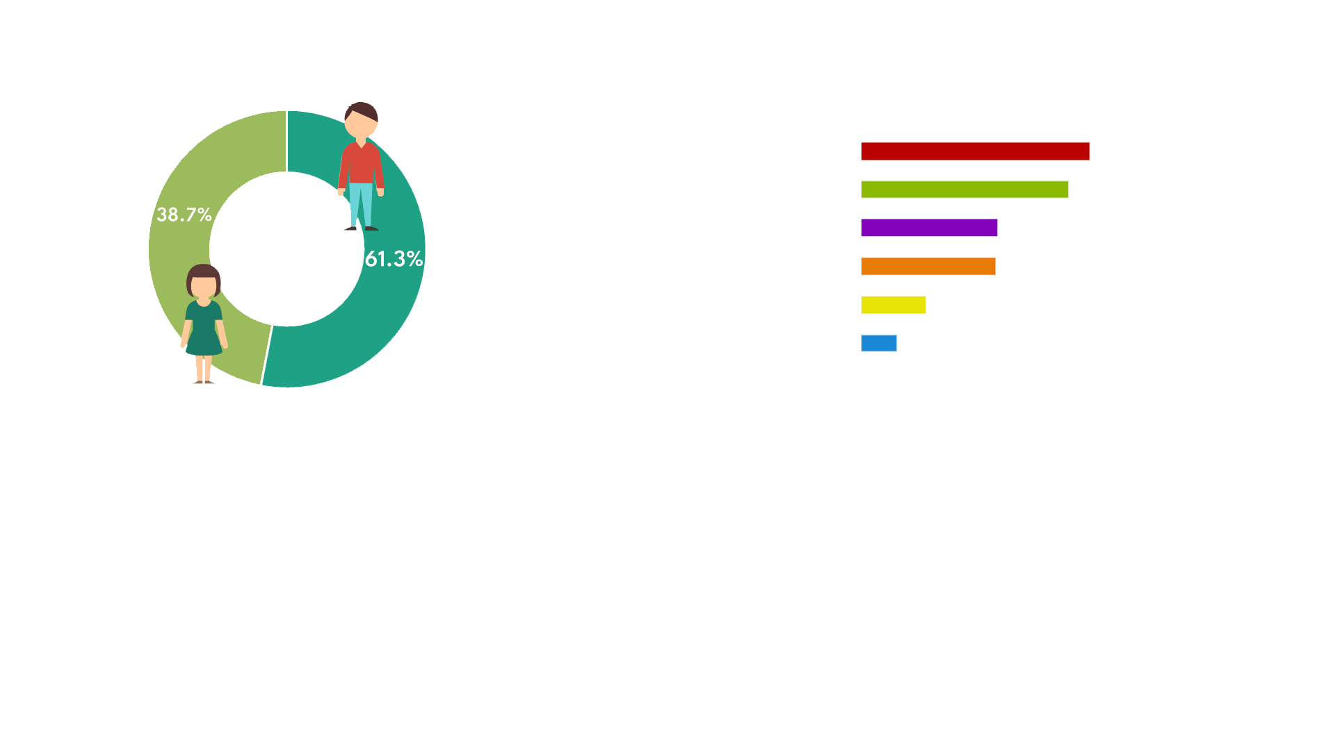
OUR DEMOGRAPHICS…
Male/Female Ratio
Age
Location
Date range used: 12th May ’22 – 11th May ’23
Source: Google Analytics

Slide 9
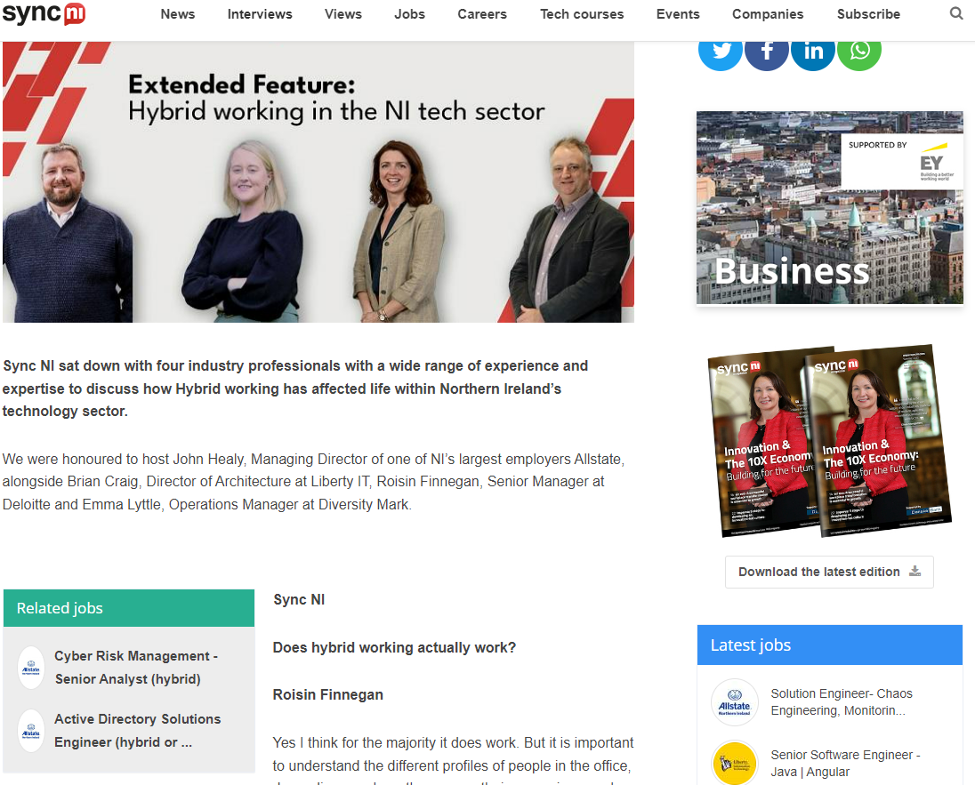
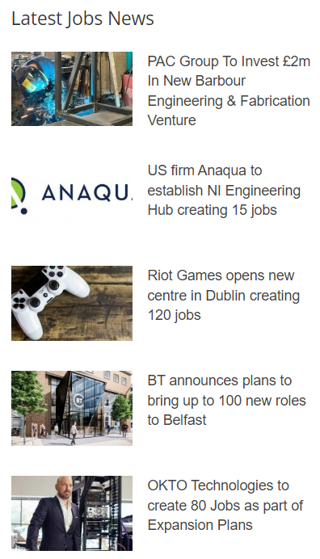
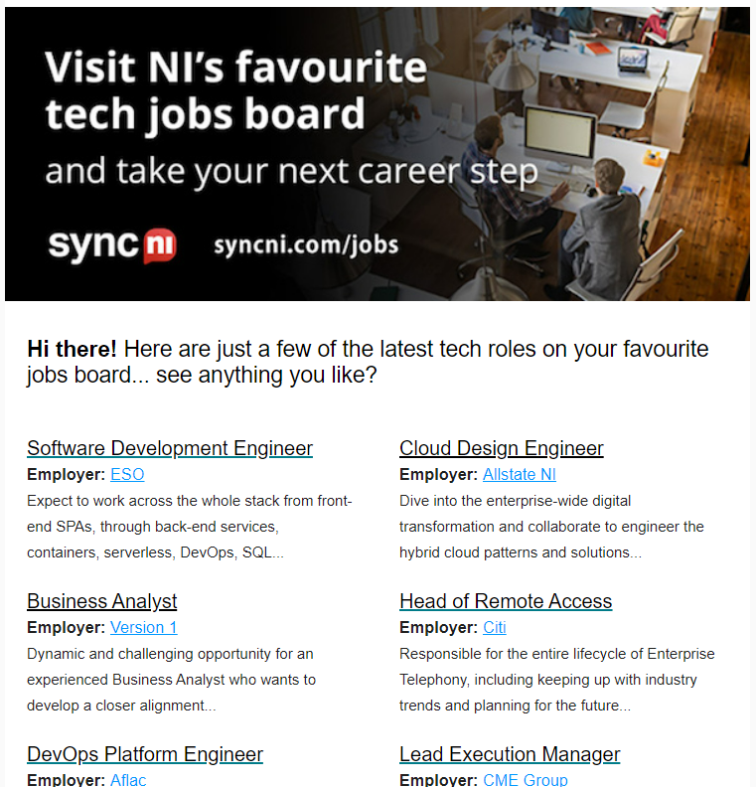
JOBS BOARD….
All jobs featured on the Jobs Board are extensively promoted across weekly email newsletters, social media channels and contextually inserted within relevant news content and editorial on SyncNI.com

Slide 10
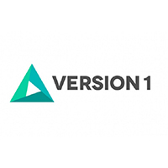






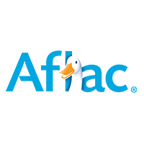
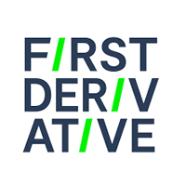



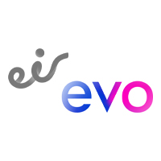








SOME OF THE ORGANISATIONS WE WORK WITH…

Slide 11

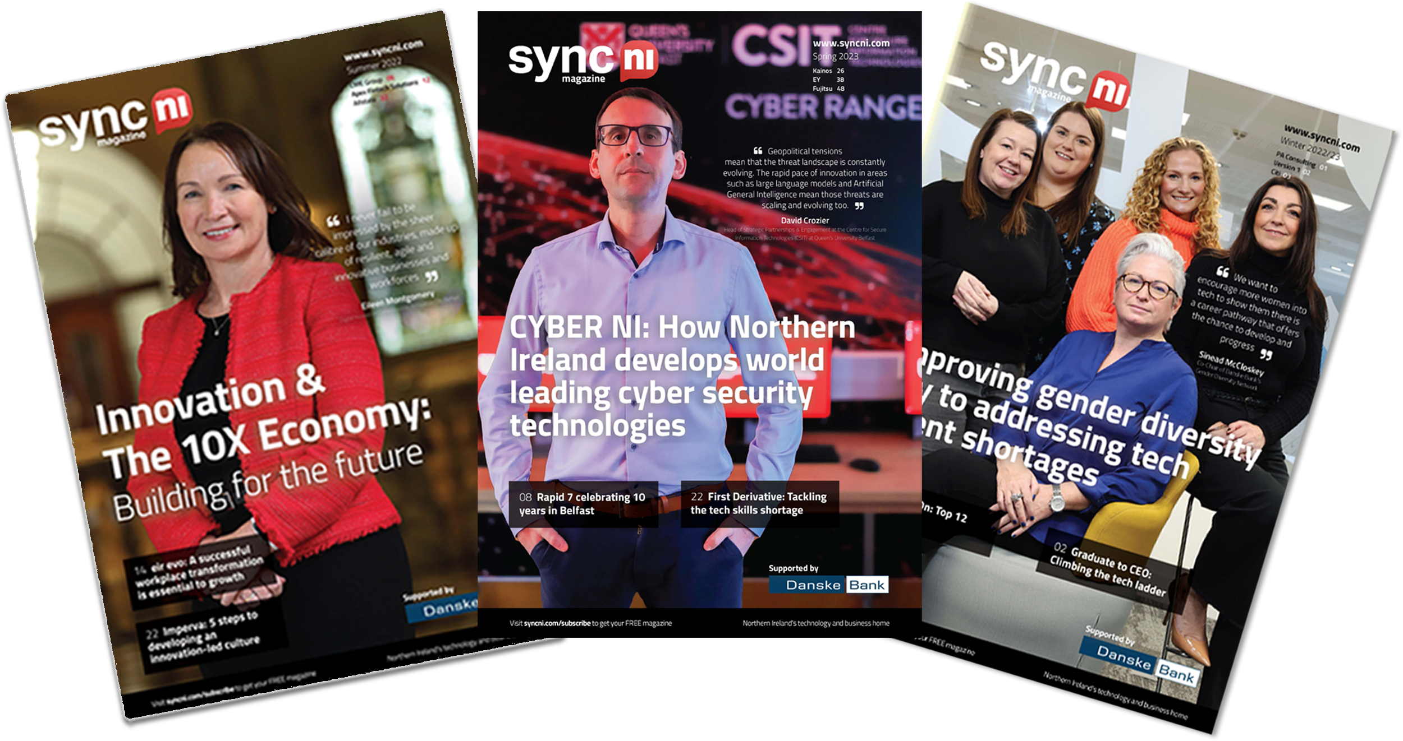
SYNC NI ANNUAL MEDIA PACKAGES (PRINT & DIGITAL)
Monthly Reach 75K+ IT Professionals & Students
Dedicated Company Hub to self-post jobs, events, and news
Interviews with Sync NI & Inclusion within ALL 4 editions of the quarterly mag
Editorial Distribution of News, Interviews, and Features Online
Digital Distribution in weekly newsletters & email alerts
Promotion across all Sync NI social media channels.
Featured interview on ‘Tech Craic’ podcast
Banner Advertising on SyncNI.com (1m impressions per year)
Invitation to roundtable and networking events
Regular content planning meetings and campaign analysis
Cost £8,000+VAT

Slide 12


SYNC NI ANNUAL MEDIA PACKAGES (PRINT & DIGITAL)
Dedicated Company Hub to self-post jobs, events and news
Interviews with Sync NI & inclusion within 2 editions of mag
Editorial Distribution of News, Interviews and Features Online
Digital Distribution in weekly newsletters & email alerts
Promotion across all Sync NI social media channels.
Banner Advertising on SyncNI.com (1m impressions per year)
Cost £5,000+VAT
Dedicated Company Hub to self-post jobs, events and news
Inclusion within 1 edition of Sync NI mag
Editorial Distribution of News, Interviews, and Features Online
Digital Distribution in weekly newsletters & email alerts
Promotion across all Sync NI social media channels.
Banner Advertising on SyncNI.com (est. 250K impressions)
Cost £3,000+VAT

